Slide 1



YOU + ME = WEALTH
Powering Collective Investment
uplus
www.uplus.rw

Slide 2
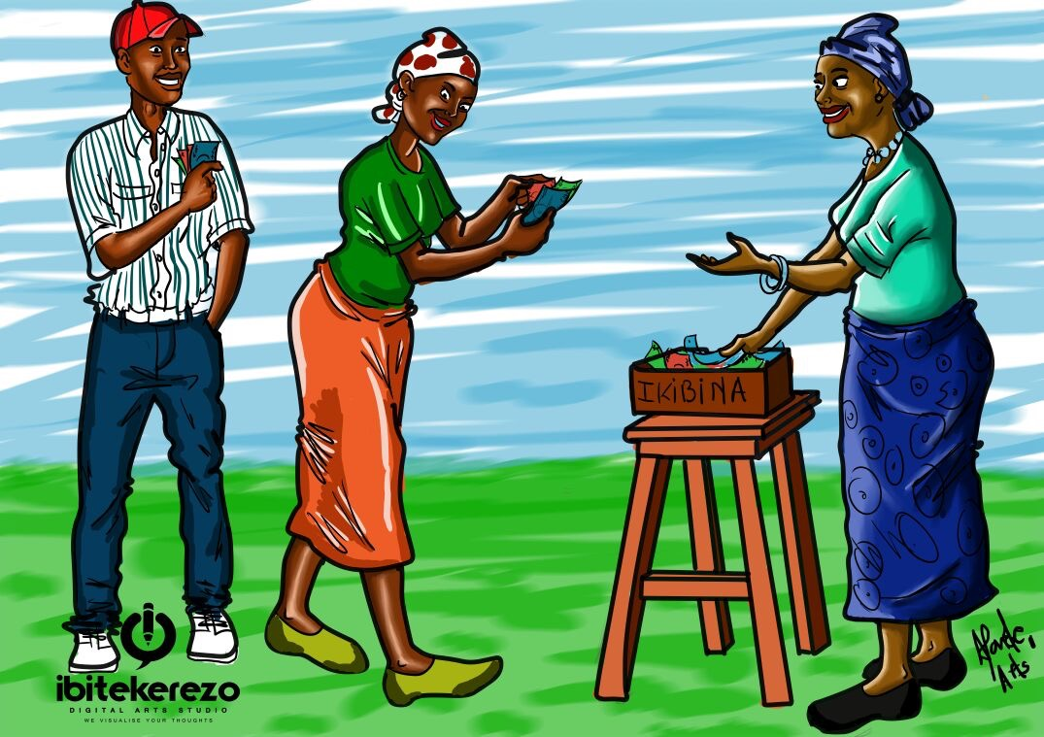

Slide 3
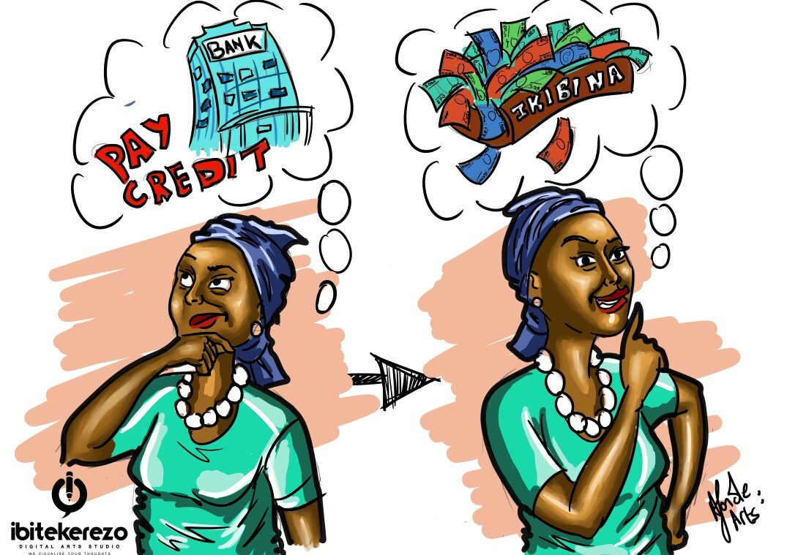

Slide 4
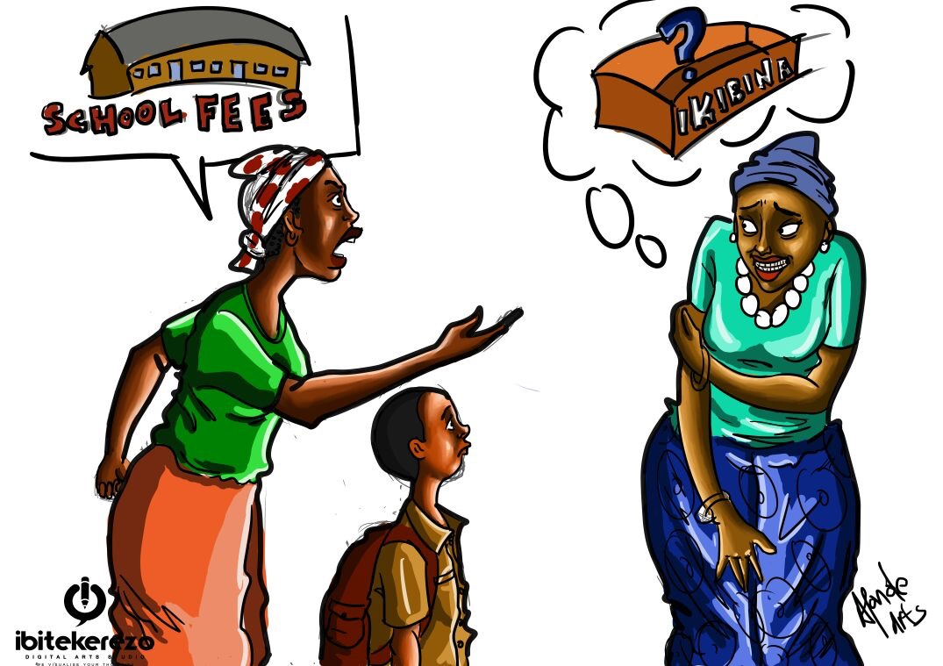

Slide 5
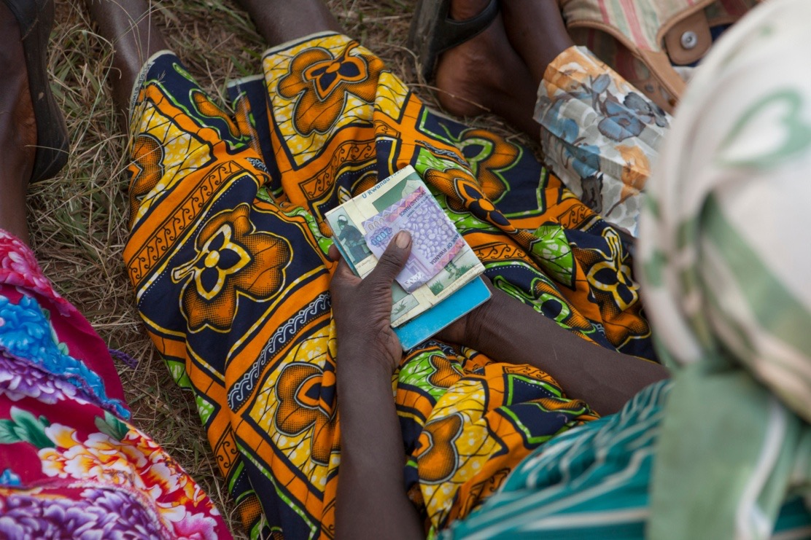
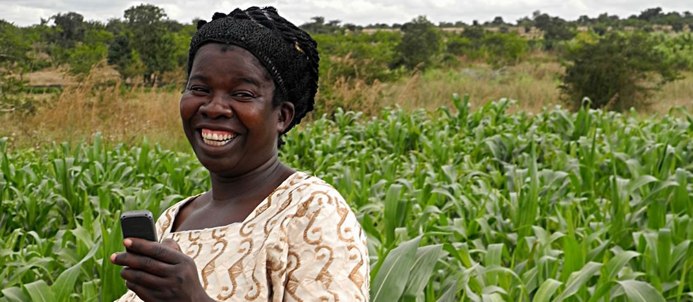

Before:
I don’t Trust that guy
My Time, Transport … ?
No interest after all?
After:

Slide 6
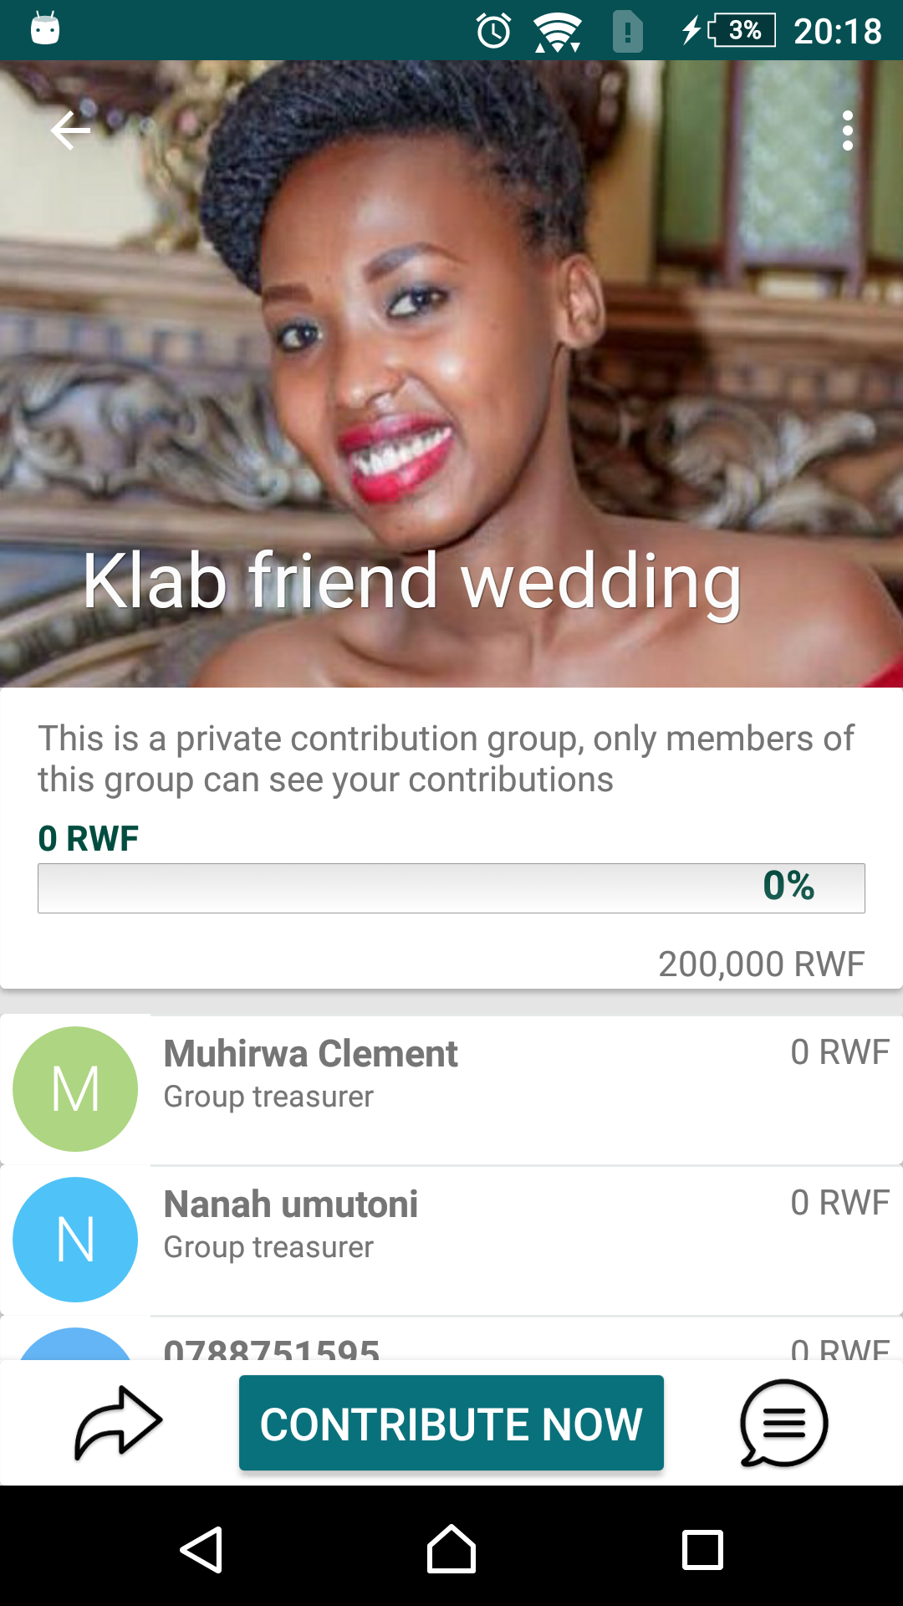
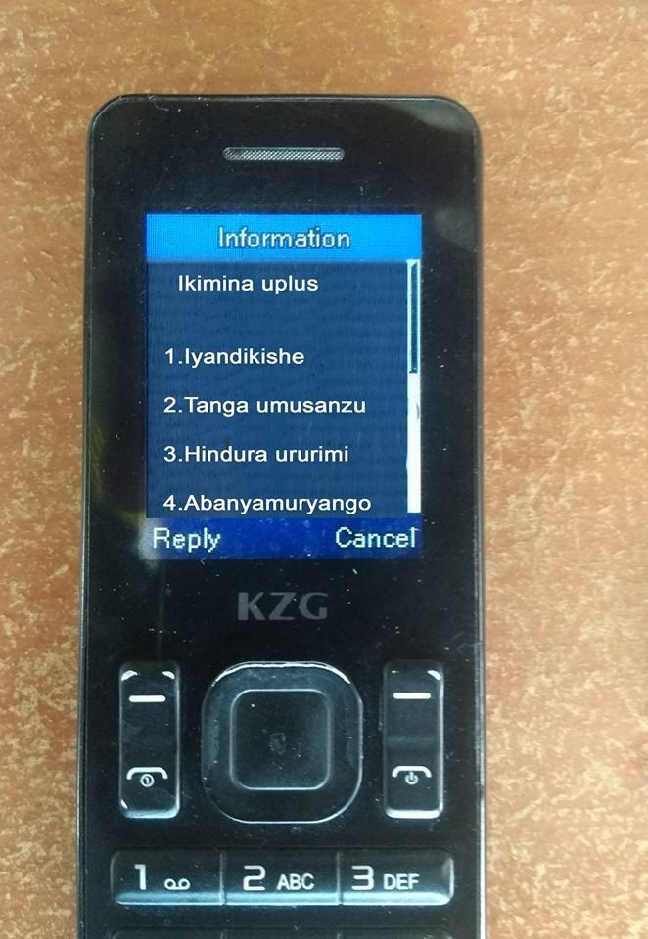
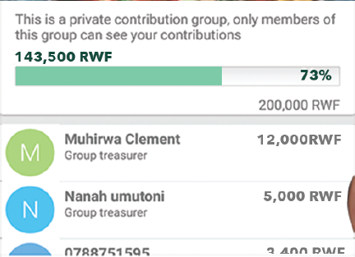
DEMO
For Urban Contributions
(Social)
For Village Contributions
(Savings)

Slide 7
Expensive
Crowdfunding
Not applicable in african market
Expansive 6% charge and above
Only accepts Visa cards.
Connivance
Hard
Uplus
Easy
Smart
Faste
Secure
Cheap
Microfinance
Hard
Manual
Time consuming
Expensive
Low Cost

Slide 8
Traction
2nd Best Fin-tech Prize in East Africa.
Initial seed capital.
Already on Web, USSD, Android.
Integration with major MNOs in Rwanda:
MTN (Rwanda & Uganda), Tigo, Visa & Master.
83 groups on the platform already.

Slide 9
BUSINESS MODEL
(Android + Web App)
Transaction fee: 3% per transaction(Mobile money, Visa & Master cards)
Savings group (USSD)
Subscription Fee: $3.6 per member
NGO Data license: $1000 / year

Slide 10
MARKET SIZE
Village Savings Market Size
Items | Groups | Members | Saved amount
In Rwanda (2016) | 28,023 | 669,751 | $16,503,571
Items | Groups | Members | Saved amount
In Africa (2016) | 435,000 | 12,000,000 | ?
Urbun contributions Market Size
. Churches
. Savings
. Parties(Weddings, Birthdays, Bridal shower, Picnic, Baby Shower etc…)
. Investments
. Fundraising.

Slide 11
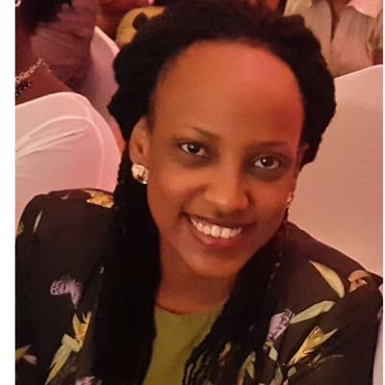
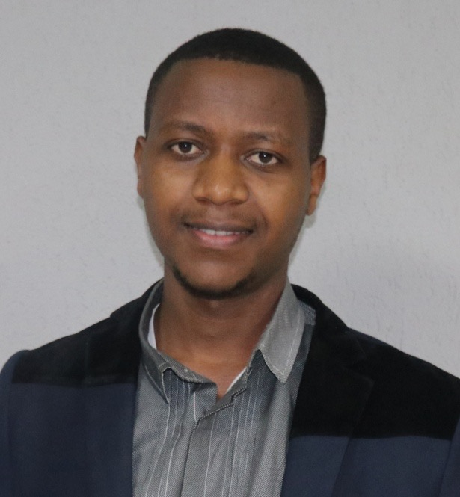
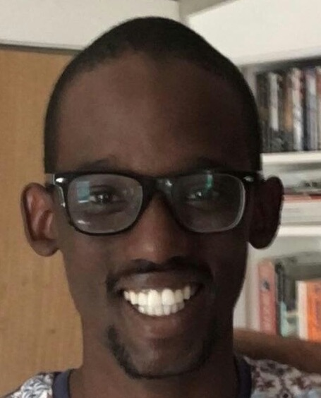
Team
Dianne Dusaidi
Co-founder CEO
Clement MUHIRWA
Co-founder
CTO
Edward KIRENGA
CFO

